Slide 1
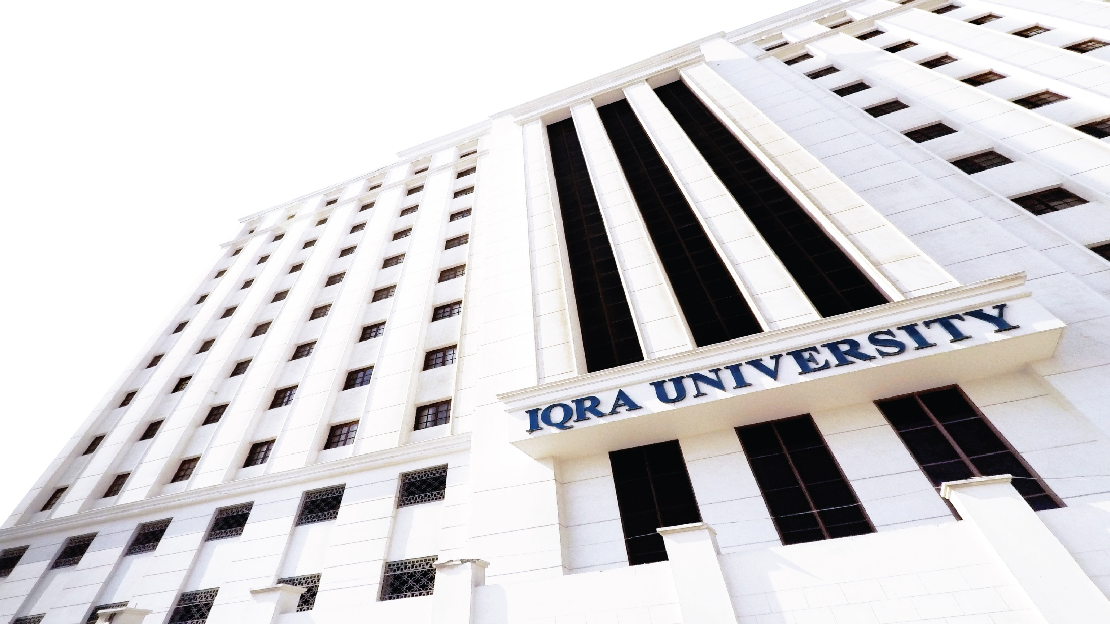

William Stallings Computer Organization and Architecture 8th Edition
Chapter 3
Top Level View of Computer Function
and Interconnection
Book by : Computer, Architecture and Organizations, 8th Edition ,William Stalling
Original Slides by : Adrian J Pullin

Slide 2
Top Level View of Computer
Function and Interconnection

Slide 3
Lecture Outcomes
Understanding of:
Computer Components
Computer Function
Instruction Fetch and Execute
Interrupts

Slide 4
Program Concept
Hardwired systems are inflexible
General purpose hardware can do different tasks, given correct control signals
Instead of re-wiring, supply a new set of control signals

Slide 5
What is a program?
A sequence of steps
For each step, an arithmetic or logical operation is done
For each operation, a different set of control signals is needed

Slide 6
Function of Control Unit
For each operation a unique code is provided
e.g. ADD, MOVE
A hardware segment accepts the code and issues the control signals
We have a computer!

Slide 7
Components
The Control Unit and the Arithmetic and Logic Unit constitute the Central Processing Unit
Data and instructions need to get into the system and results out
Input/output
Temporary storage of code and results is needed
Main memory

Slide 8
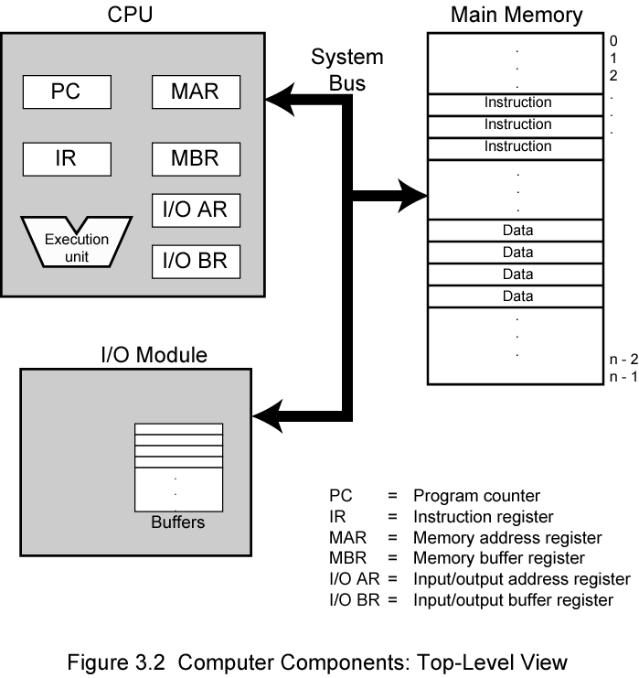
Computer Components : Top Level View

Slide 9
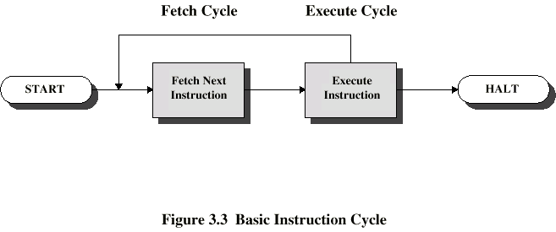
Instruction Cycle
Two steps:
Fetch
Execute

Slide 10
Fetch Cycle
Program Counter (PC) holds address of next instruction to fetch
Processor fetches instruction from memory location pointed to by PC
Increment PC
Unless told otherwise
Instruction loaded into Instruction Register (IR)
Processor interprets instruction and performs required actions

Slide 11
Execute Cycle
Processor-memory
data transfer between CPU and main memory
Processor I/O
Data transfer between CPU and I/O module
Data processing
Some arithmetic or logical operation on data
Control
Alteration of sequence of operations
e.g. jump
Combination of above

Slide 12
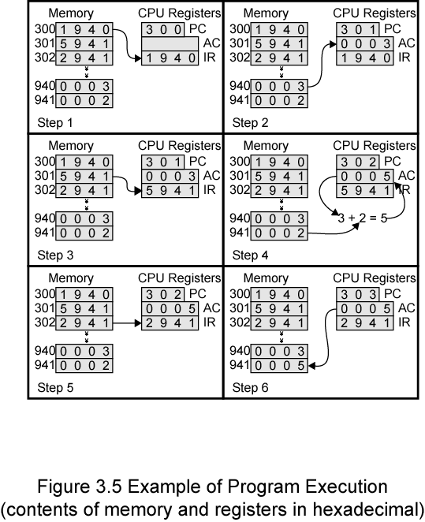
Example of Program Execution

Slide 13
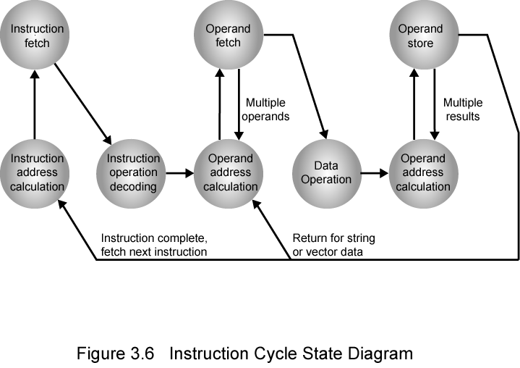
Instruction Cycle State Diagram

Slide 14
Interrupts
Mechanism by which other modules (e.g. I/O) may interrupt normal sequence of processing
Program
e.g. overflow, division by zero
Timer
Generated by internal processor timer
Used in pre-emptive multi-tasking
I/O
from I/O controller
Hardware failure
e.g. memory parity error

Slide 15
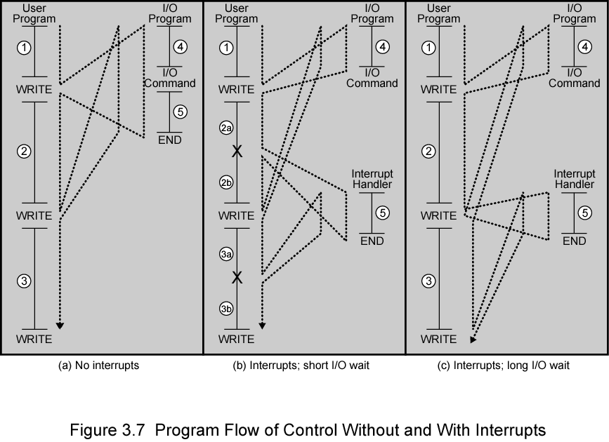
Program Flow Control

Slide 16
Interrupt Cycle
Added to instruction cycle
Processor checks for interrupt
Indicated by an interrupt signal
If no interrupt, fetch next instruction
If interrupt pending:
Suspend execution of current program
Save context
Set PC to start address of interrupt handler routine
Process interrupt
Restore context and continue interrupted program

Slide 17
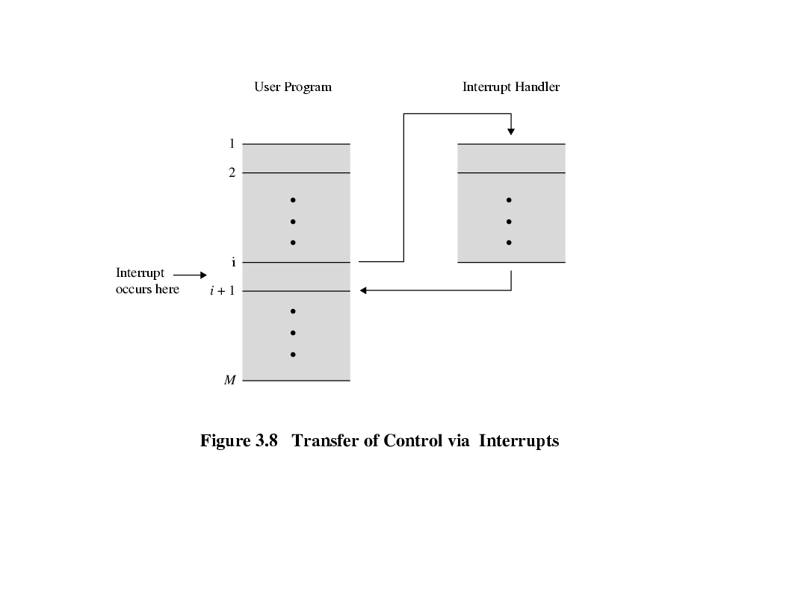
Transfer of Control via Interrupts

Slide 18
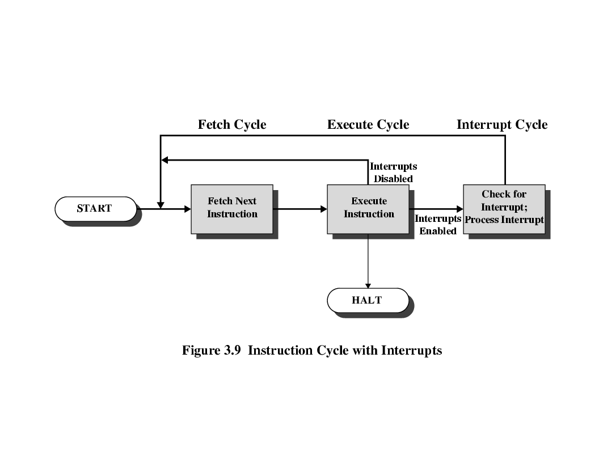
Instruction Cycle with Interrupts

Slide 19
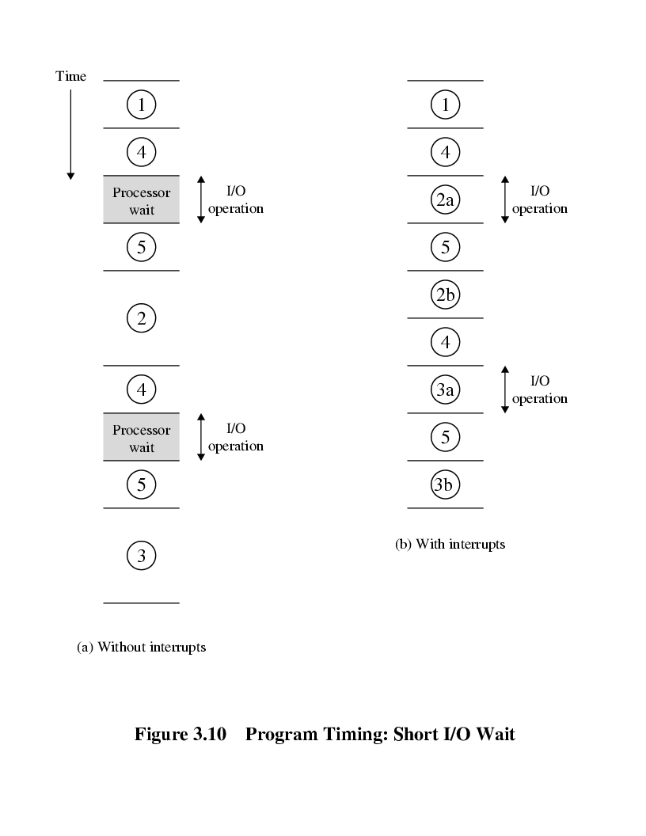
Program Timing Short I/O Wait

Slide 20
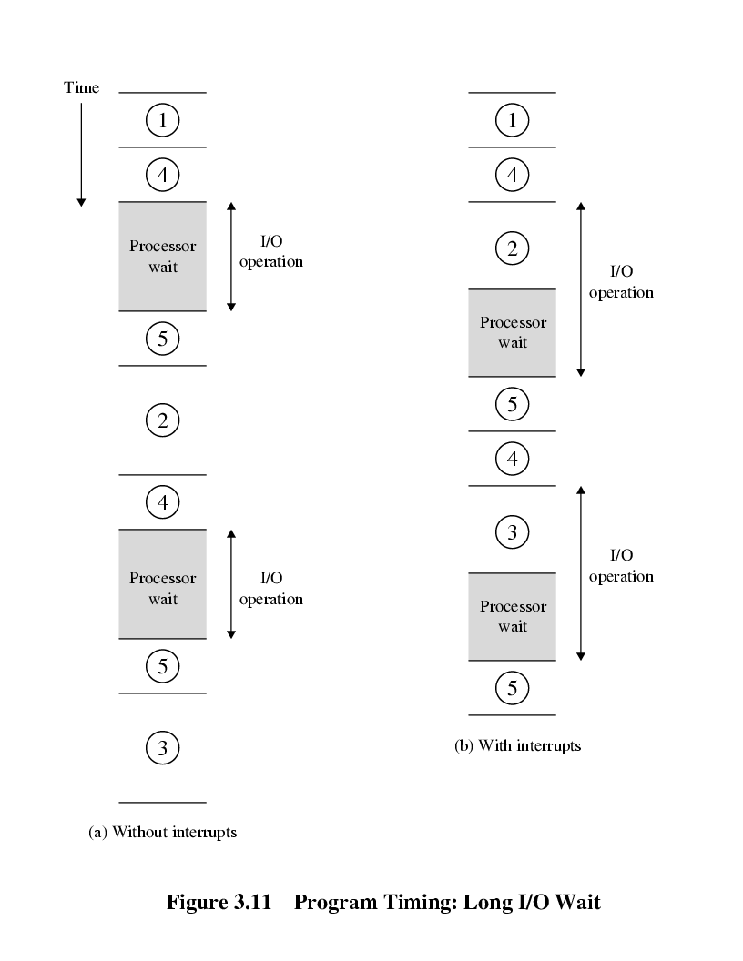
Program Timing Long I/O Wait

Slide 21
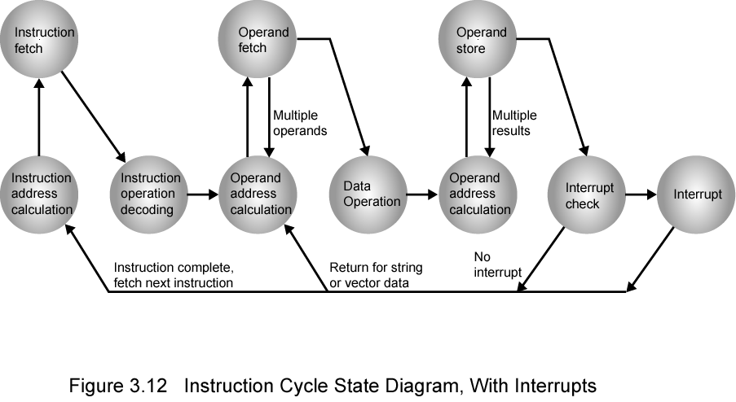
Instruction Cycle (with Interrupts) - State Diagram

Slide 22
Multiple Interrupts
Disable interrupts
Processor will ignore further interrupts whilst processing one interrupt
Interrupts remain pending and are checked after first interrupt has been processed
Interrupts handled in sequence as they occur
Define priorities
Low priority interrupts can be interrupted by higher priority interrupts
When higher priority interrupt has been processed, processor returns to previous interrupt

Slide 23
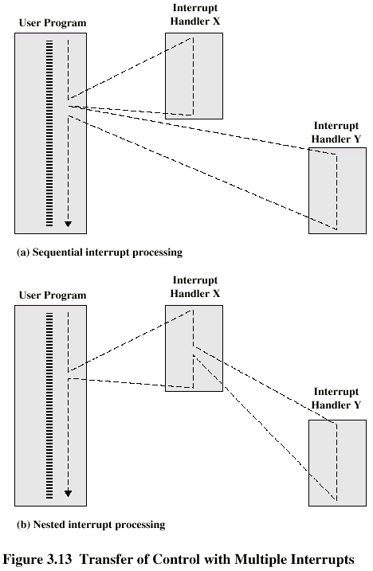
Multiple Interrupts - Sequential

Slide 24
Multiple Interrupts – Nested

Slide 25
Review Questions
What general categories of functions are specified by computer instructions?
List and briefly define the possible states that define an instruction execution.
List and briefly define two approaches to dealing with multiple interrupts.

Slide 26
Thank you

